Slide 1
Animal Breeding Techniques and Technologies

Slide 2
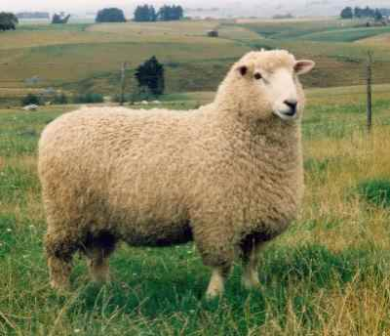
Embryo Transfer

Slide 3
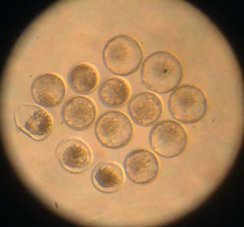
Embryo Transfer (ET)
What is ET?
Fertilized embryos are removed from the uterus horn of a superovulated “donor” and transplanted into a synchronized “recipient” uterus
14 Embryos ready for transfer
Why use ET?
To make widespread use of females with high genetic merit: the female equivalent of AI.
Naturally mated ewe: 1-3 lambs per year
ET: up to 50 lambs can be produced per year
Disadvantages
Costly, labour intensive, requires technical expertise
Notes:
More offspring can be produced from a superior female than possible by natural mating

Slide 4
ET Programme
Progesterone CIDR
0
Progesterone CIDR
10
DONOR (1)
FSH injected twice daily
RECIPIENTS (6-14)
12
PMSG injection
Remove CIDR
13
Remove CIDR
Mating (AI or natural)
14
GnRH injection
15
CIDR: controlled internal drug release
PMSG: pregnant mare serum gonadotrophin
GnRH: gonadotrophin releasing hormone
FSH: follicle stimulating hormone
Recovery of embryos
21
Embryos transplanted
Notes:
GnRH stimulates Lutenizing hormone release, LH release stimulates ovulation

Slide 5
Embryo collection in sheep

Slide 6
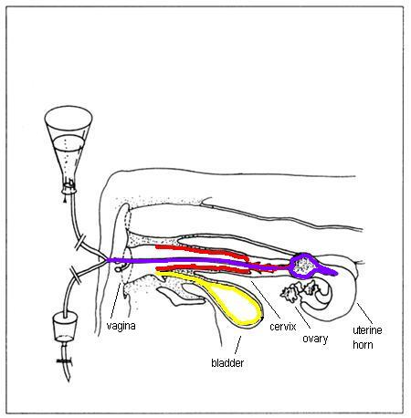
Embryo collection in Cows

Slide 7
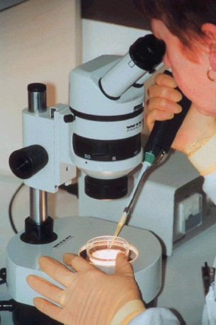
ET Technique
Donor is fasted for 12-24 hours
Donor is prepared for surgery: anesthetized, put on surgical table, wool clipped, site sterilized
Uterus and ovaries are exteriorised
Corpus luteum are detected
Eggs are recovered from uterus horns by flushing a sterile solution through with a foley catheter. Solution containing the embryos is collected in a watch glass
Embryos are examined under microscope, only good quality embryos at correct stage of development are selected for transplant to the recipients
Notes:
Show foley catheter and dish
Correct stage of development: approx 8 cell stage, blastocyst
Make distinction between flushing/increasing feed and flushing the embryos

Slide 8
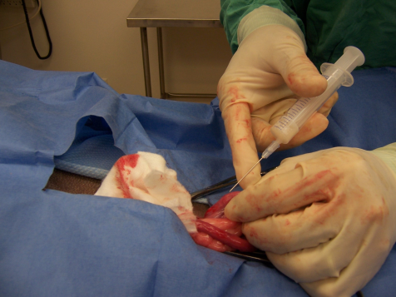
ET Technique
Recipient is fasted for 12-24 hours
Recipients are prepared for surgery: sedated, put in cradle, wool clipped, site sterilized, local anesthetic
Abdomen is punctured with trocar, a laparoscope (light source) is inserted
Corpus luteum are detected
Forceps are inserted to exteriorise a uterus horn
1-2 embryos are implanted into the uterus horn with a pipette
The embryo develops in the recipient as if it were her own
Notes:
Emphasize that we are flushing only one donor, but transferring embryos to many recipients
Number of embryos implanted depends on species, sheep are usually two, cattle only one

Slide 9
ET End Result

