Slide 1
Oestrus
Definition: Oestrus is when a cow “comes into heat”. This is when a cow will accept a bull for mating.
Note: when used correctly, “oestrous” means something that relates to oestrus, such as the oestrous cycle. The two can commonly be used interchangeably
Oestrus is often spelt Estrus.

Slide 2
Oestrus
For much of her life, a cow’s body is hostile to sperm.
The cervix locks up tight and forms a tight, hardened mucus plug
The oviducts clamp tight to prevent eggs from leaving the ovaries and sperm from entering
Hormones prevent the fertilization of an egg
However, once every 21 days, she will change behaviorally and physiologically to allow, even encourage fertilization.
~

Slide 3
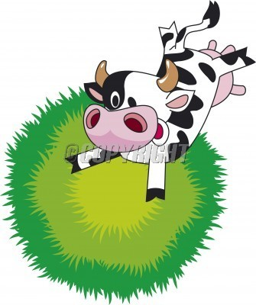
Oestrus
General signs of cows in heat
Increased nervousness
Swollen vulva
Licking other cows
Reduced feed intake
Best signs
Stands to be mounted (rather than mounts)
Clear mucus discharge
~

Slide 4
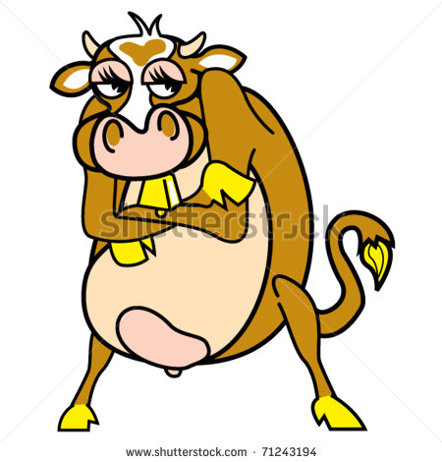
Oestrus
This is a crucial, small window of time for the farmer to make sure that the cow is fertilised.
Reproduction is dependent on fertilisation
Fertilisation can only happen when the cow’s body says it can happen.
If the farmer misses this window, his profits will decline, no new offspring, no milk.

Slide 5
Female Reproductive Physiology
A farmer needs to understand how the female reproductive system works.
It is crucial to understand both the structures and the hormones that allow both oestrus and reproduction.
These structures and hormones interact to create the situations producers must deal with.

Slide 6
BASIC ANATOMY OF THE COWS REPRODUCTIVE SYSTEM
The cow's reproductive system has four basic functions.
To produce ova (eggs) which provides half of the eventual offspring's genetic makeup.
To provide an environment and conditions for the fertilization of those ova.
To provide a place following fertilization for the nourishment and fetal development of the calf.
To provide a mechanism for the birth of the calf.
Use the text to fill out the missing labels on your diagram.

Slide 7
Female Reproductive Structures

Slide 9
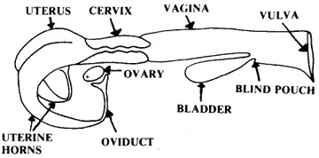

Slide 10
Vulva
“Entranceway” of the female reproductive tract
Swells and becomes reddish-pink during oestrus
Response due to the hormone oestrogen
~

Slide 11
Vagina
flattened tube; passage between the cervix and the vulva
Site of semen deposition during natural insemination and used as a passageway for instruments during AI

Slide 12
Cervix
the muscular “valve” or “control gate” between the uterus and the vagina
During pregnancy, a hard mucus plug “glues” it shut to protect foetus

Slide 13
Uterus & Uterine Horns
where the foetus grows.
Muscular, capable of “enormous expansion”
Has to support up to 80 kg / 177 lbs of weight
Uterine Horns
The extensions on either side of the uterus that lead to the oviducts

Slide 14
Oviducts (Fallopian Tubes)
tubes that carry eggs from ovaries to uterus
Where fertilization occurs
Motile sperm meet the egg in the upper part of the oviduct
Newly formed zygote stays in the oviduct 3-4 days
This time is needed for the uterus to prepare itself
~

Slide 15
Medical animation of egg fertilization
http://www.youtube.com/watch?v=oSx9t5pof88

Slide 16
Ovaries
Small walnut-shaped ovals 4-6 cm / 2-3 inches in length
Contain thousands of ova (plural of ovum, or egg cell)
These were created before the birth of the cow
Has a finite supply, as do human females
~

Slide 17
Ovaries (cont.)
Functions:
Produce a mature ovum (egg) every 21 days
Produce/secrete hormones that:
Control growth of egg
Change cow’s behaviour (gets her “in heat”)
Prepare reproductive tract for pregnancy
Start birthing process
Prepare mammary glands for lactation

Slide 18
Follicles
start as cavities (holes) on the ovary
An egg moves to this cavity.
It is surrounded by support cells and nutritive substances
All these things together are the follicle
Follicle protects the egg

Slide 19
Infundibulum
Latin for “funnel”
The end bit of the oviducts that surrounds, but does not connect to, the ovaries
“Funnels” eggs from ovaries into oviduct.
~

Slide 20
Corpus luteum
The cells that remain in the follicle after the egg is ovulated (expelled into the oviduct)
Produces progesterone, a hormone which allows pregnancy to “progress”

Slide 21
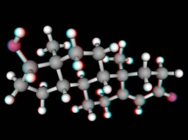

Slide 22
Egg (ovum)
Female gamete (reproductive cell)
Haploid - half the number of normal chromosomes

Slide 23
How they change during oestrus
Vulva: swells due to oestrogen, covered in mucus
Vagina: excess mucus production
Cervix: dilates to allow acceptance of semen (otherwise locked shut with hardened mucus to prevent infection)
Oviducts: open to allow ovulation, fertilization
Ovaries: ovulation – release of the follicle (egg and some supporting cells) from the ovary
number of young that a female can produce at one time is determined by how many eggs are released during ovulation
ovulation usually occurs at the end of a heat/oestrus

Slide 25
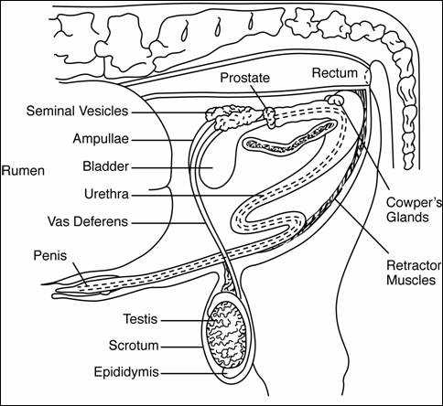
Bull reproductive system

Slide 26
Hormones
Hormones are proteins that are chemical messengers secreted by endocrine glandsm and carried by blood to different target tissue to give a specific effect.
They produce signs of being on heat, the release of the egg from the ovary, maintain pregnancy, and regulate almost all aspects of reproduction.

Slide 27
Hormones
Hormone function and interaction
GnRH – Gonadotropin releasing hormone
Regulates the secretion of FSH
Cause developing follicles to be released
Stimulates the growth of new immature follicles

Slide 28
Hormone
FSH – Follicle Stimulating Hormone
Stimulates growth of follicles on the ovary
LH – leutenizing hormone
Promotes ovulation (release of follicle)

Slide 29
Hormones
Oestrogen – Jack of all trades (no abbreviation)
Causes behavioral changes in the cow
Causes LH surge just prior to release of follicle
Necessary to ensure that sperm and egg meet
Stimulates muscular contractions that move egg into oviduct, contractions in vagina and uterus to move sperm towards oviduct.

Slide 30
Hormones
Progesterone
Prepares uterus for pregnancy
Prevents development of new follicles during pregnancy
Prevents recurrence of oestrous cycle during pregnancy ~

Slide 31
Hormones
Prostaglandins (PGF_{2α})
Uterus secretes this in non-pregnant cows
Cause the corpus luteum to regress and stop producing progesterone
Follicles are no longer inhibited and can grow and develop
In animals with a mature corpus luteum, a heat typically occurs 2-7 days after an injection of prostaglandins ~

Slide 33
Summary of Oestrus
Day 20 and 21 (of previous cycle) – Corpus luteum decays; final maturation of a follicle for the next cycle begins
Day 1 and part of Day 2 (30 hours total): estrus (heat period), the point of sexual receptivity.
The only time that a cow will allow herself to be mounted.
Egg and follicle reach final maturation. ~

Slide 34
Summary
Day 2-5 [Starting 10-14 hours after last sign of estrus]: follicle is expelled from the ovary into the oviduct (a.k.a. ovulation).
Wall of ruptured follicle that remains on the surface of the ovary will become the corpus luteum.
Days 6-16: corpus luteum is large and fully functional.
Some growth of follicles which will not fully mature until current corpus luteum regresses, at which time a dominant follicle will emerge and eventually ovulate in the next cycle. ~

Slide 35
Hormones
Days 16-20: Corpus luteum will start to regress. The uterus will begin to try to detect the presence of an embryo.
if no embryo: the uterus will send a signal to the corpus luteum telling it to regress so that a new cycle can begin.
If egg has been fertilized, the cow is pregnant and the corpus luteum will continue to produce hormones that inhibit follicular development.
Day 20 – 21 – Corpus Luteum decays if there is no fertilized egg;
final maturation of a follicle for the next cycle begins. ~

