Slide 1
AIR

Slide 2
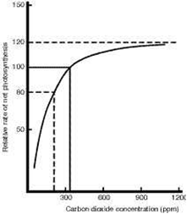
Increasing Carbon Dioxide levels from .03% to between 0.08 and 0.1% could increase plant yield by 20-30%.

Slide 3
The maximum rate of photosynthesis will depend on the presence of limiting factors. These factors will prevent the rate of photosynthesis from rising above a certain level.
For example:

Slide 4
Oxygen is 20% of the air, so with good air flow oxygen is rarely lacking. I fact, too much Oxygen can reduce the plants use of Carbon Dioxide so can reduce photosynthesis rates.

Slide 5
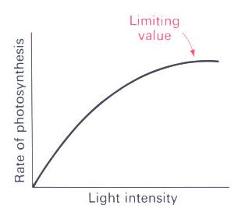
This graph shows the maximum value at which increasing light intensity will increase the rate of photosynthesis.
Increasing light intensity will increase the rate of photosynthesis. Once light intensity reaches about 30,000 lux, the rate of photosynthesis will not increase any more.

Slide 6
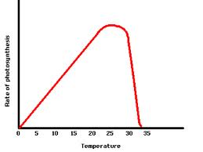
Increasing the temperature from 10ºC to 20ºC doubles the rate of photosynthesis as the plant's enzymes will be closer to their optimum working temperature. If the temperature is raised above about 30 degrees, the rate of photosynthesis will drop as the plant's enzymes are denatured (broken apart)

Slide 7
The amount of water available to the plant will affect the rate of photosynthesis. If the plant does not have enough water, the plant's stomata will shut and the plant will be deprived of Carbon Dioxide, reducing the rate of photosynthesis.
NB
Only a small fraction of the water plants take up is needed for photosynthesis. The rest is needed in chemical reactions and to maintain cell shape. The lack of carbon dioxide, not water, is the limiting factor of photosynthetic rate.

Slide 8
So… if carbon dioxide enrichment methods are used to increase productivity there must be high light intensity (above 30,000 lux), plenty of water and a temperature of around 20ºC to eliminate these limiting factors.

